Slide 1


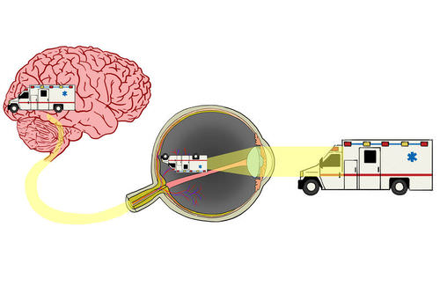
Medical physics first year
L15- Physics Of Eyes And Vision
By Assistants professor
Dr.Ghania Salim Al-Thaher
Physiology Department
College of Medicine
University of Basrah

Slide 2
Learning Objectives
By the end of this section, you will be able to:
Optical System Features
Learning focusing elements of the eye
The cornea
The lens
Ciliary muscle
The Retina
The blind spot of the eye

Slide 3
Physics Of Eyes And Vision
The sense of vision consists of three major components: -
The eyes that focus an image from the outside world on the light-sensitive retina.
The system of millions of nerves that carries the information deep into the brain.
The visual cortex-that part of the brain where "it is all put together".
Blindness results if any one of the parts does not function.

Slide 4
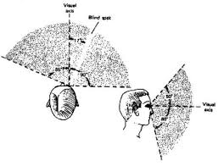

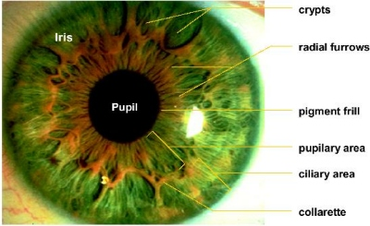
Optical System Features
Eye can observe events over a large angle while concentrating on an object directly ahead of it.
2. Blinking provides a built-in lens cleaner and lubricator.
3.The eye has an automatic aperture adjustment (the iris) to control the pupil size

Slide 5
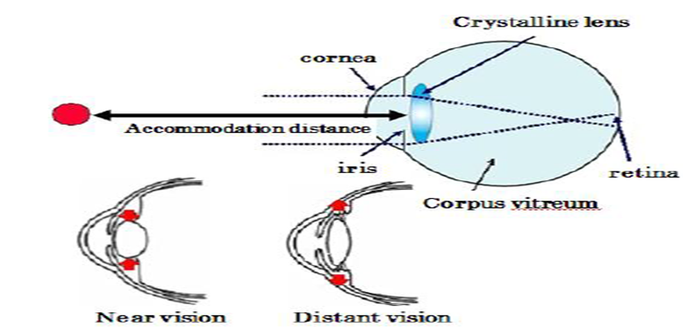
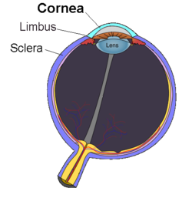
4.The eye has a rapid auto-focus system called accommodation.
It can quickly
focus from an object only 20 cm away to one far away in the distance. A relaxed eye is focused for an object at infinity (distant viewing).
5. The eye can adapt to light ranges of almost a billion to one (10¹⁰:1), bright daylight to very dark night.
6. The cornea had a built-in scratch remover. The cornea is made of living cells that can repair local damage.

Slide 6
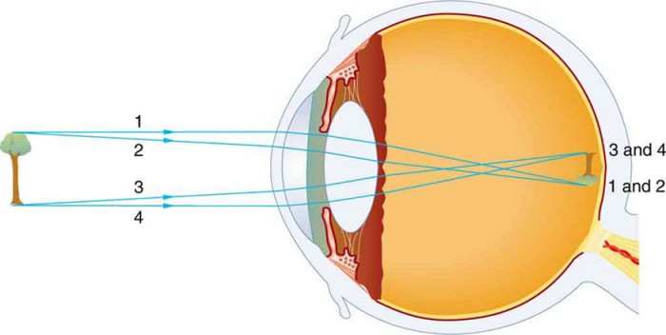
7.The image appears inverted or upside down, on the retina, but the visual cortex automatically corrects for this.
8. The visual cortex blends the images from both eyes, giving us good depth perception and three-dimensional viewing.
Even if vision is lost in one eye, the vision from the healthy eye is sufficient for normal day-to-day function.

Slide 7
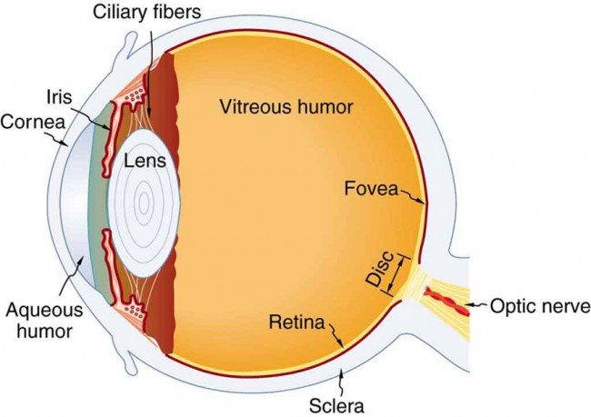
Focusing Elements Of The Eye
The eye has two major focusing components:
1-The cornea is a fixed focus element.
That is responsible for two-thirds of the focusing(refractive power of the eye 54 diopters).
The cornea is the transparent part of the sclera where light enters.
It is curved to help to focus by refraction.

Slide 8
It is a protective transparent layer at the front of the eye.
It has a fixed convex curvature and therefore acts as a ‘fixed focus’ lens.
The cornea is focus by refraction ( bending ) the light rays.
It.

Slide 9
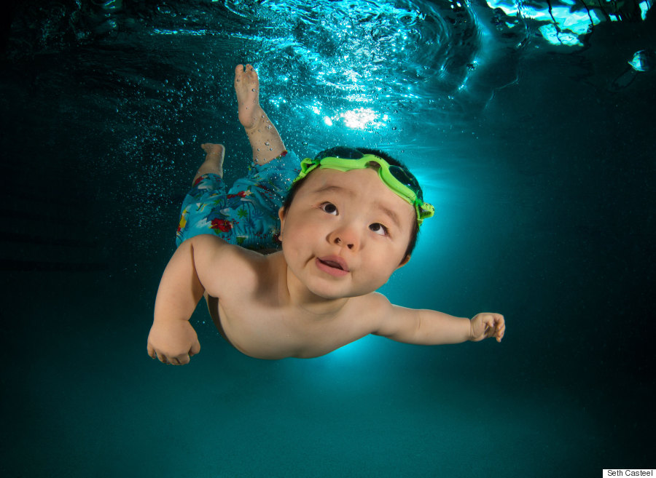
The amount of bending depends on :
The curvatures of its surfaces.
The speed of light in the lens compared with that in the surrounding material(relative index of refraction)
When the cornea is under –water it loses most of its focusing power
Because the index of refraction of water (1.33) is close to that of cornea(1.37)
n= V_{o} /V = λ̥ /λ = C/V
λ̥ :wave length in vacuum.
λ :wave length in medium

Slide 10
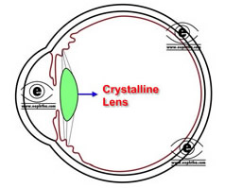
2- The lens (crystalline lens) : a transparent biconvex structure in the eye, situated behind the iris, that focuses incident light on the retina.
Variable in shape and has the ability to focus objects at various distances by change the focal length of the eye , thus allowing a sharp real image of the object of interest to be formed on the retina.

Slide 11
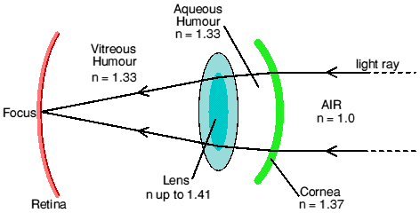
In humans, the refractive power of the lens in its natural environment is approximately 18 diopters, roughly one-third of the eye's total refractive power of the eye (54 diopters).
Has focusing properties at both its front and bake surface
The effective index of refraction is thus about 1.4

Slide 12
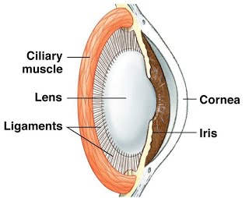
The lens attached to the ciliary muscles.
The ciliary muscles are the smooth muscles that are found in the middle of the eye layer and surrounds the lens.
What is the function of the ciliary muscle?
These muscles controls the accommodation of the eye and may help in viewing the objects at different distances.
The ciliary muscles also control the flow of the
aqueous humor.

Slide 13
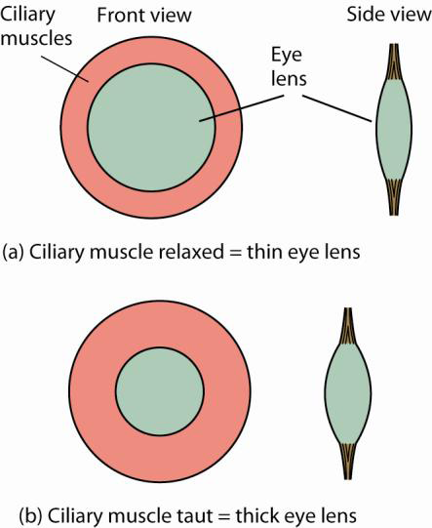
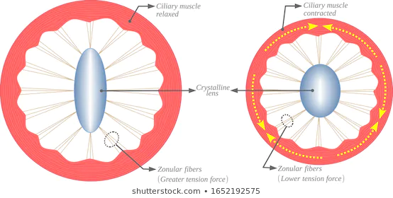
3. The ciliary muscles also help in changing the shape of the lens within the eye. This cannot change the size of the pupil.
4. The ciliary muscles also help in focusing of the objects.

Slide 14
It contracts or relaxes in order for an individual to see at multiple distances.
Suspensory ligament of lens - a series of fibers that connect the ciliary body of the eye with the lens, holding it in place.
Unlike the optical lenses created by man, the eyes are able to fine tune their lenses to improve focus.
The lens, and the cornea, can be damaged by ultraviolet and other forms of radiation.
It can develop cataracts, which destroy its clarity ,
It’s possible to remove a damage lens surgically and add extra correction to glasses.

Slide 15
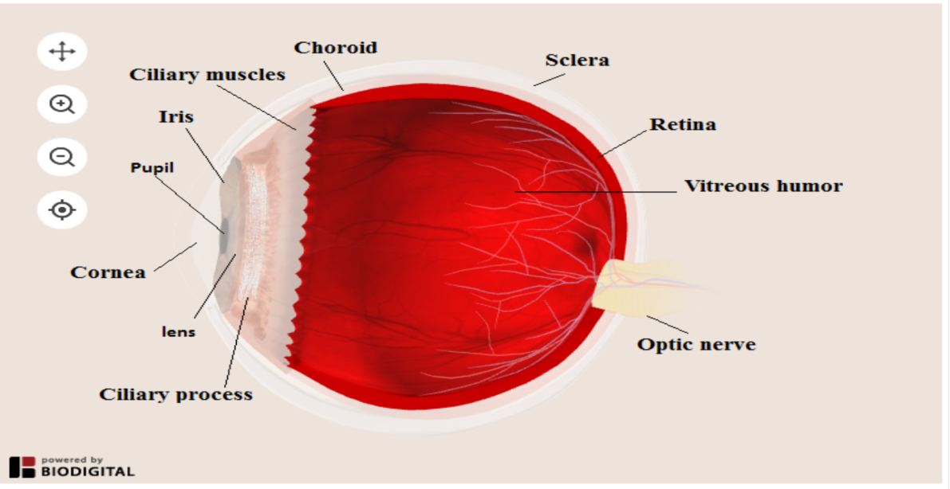
3.The Retina (the light detector of the eye) :
The retina is a light-sensitive thin layer of tissue that lines the back of the eye on the inside covers about 65 percent of its interior surface.
It is located near the optic nerve.
The purpose of the retina is:
To receive light that the lens has focused,
Convert the light into neural signals,
Send these signals on to the brain for visual recognition.

Slide 16
Photosensitive cells called rods and cones in the retina convert incident light energy into signals that are carried to the brain by the optic nerve.
The absorption of visible light with energy > 1eV causes a photochemical reaction in the photoreceptor and initiates the action potential then light image convert into electrical signal sent to the brain through the optic nerve.
The role of the retina in the eye is similar to that of film in the camera.

Slide 17
https://www.healthline.com/human-body-maps/retina#1
3D model with move

Slide 18
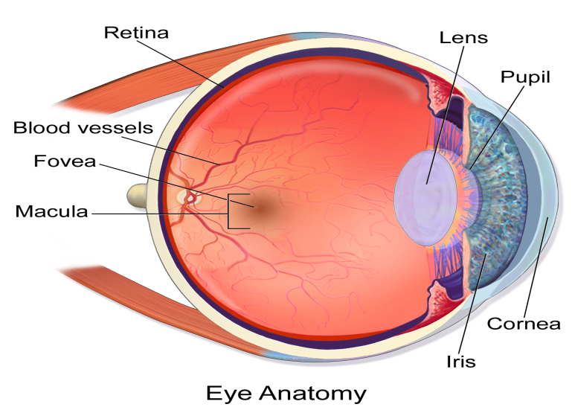
The retina covers the back half of the eyeball. Most vision is restricted to a small area called macula lutea, or the yellow spot(~0.3mm).
Because the macula is yellow in color it absorbs excess blue and ultraviolet light that enter the eye and acts as a natural sunblock (analogous to sunglasses) for this area of the retina.
In the middle of the retina is a small dimple called the fovea or fovea centrals. It is the center of the eye's sharpest vision and the location of most color perception.

Slide 19
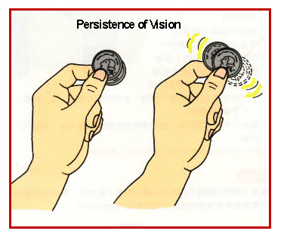
The sensation of an image remains on the retina of the eye for only 1/16th of a second. This is known as "persistence of vision", and is made use of in movies

Slide 20


